Slide 1
Orientation Class
Computer Programming – I (24CP101T)
Course Coordinator
Dr. Darshit SHAH
Email: darshit.shah@spt.pdpu.ac.in
Mob: 9825874525
Dr. Azriel Henry
Email: Azriel.Henry_ad@sot.pdpu.ac.in
Course Faculty: Arjun Vankani
Email: vankaniarjun0103@gmail.com
School of Technology,
Pandit Deendayal Energy University, Gandhinagar

Slide 2
Course Structure
Pandit Deendayal Energy University |  |  |  |  |  |  |  | School of Technology
24CP101T |  |  |  |  | Computer Programming-I
Teaching Scheme |  |  |  |  | Examination Scheme
L | T | P | C | Hr/Week | Theory |  |  |  | Practical |  | Total Marks
 |  |  |  |  | IA | Mid | ES |  | LW | LE/Viva
1 | 0 | 0 | 1 | 1 | 25 | 25 | 50 |  |  |  | 100

Slide 3
Course Details
Learning objectives:
To understand the usage of operators and data types.
To apply different types of Conditional and looping statement.
To create different types of data collections.
To implement user-defined function.
To perform different operations upon files.

Slide 4
Course Outcomes
On completion of the course, student will be able to
CO1: Understand the basics of programming.
CO2: Identify different programming constructs for a problem.
CO3: Apply appropriate derived data type for data storage.
CO4: Prepare a user-defined data type based on data attributes.
CO5: Construct user-defined functions for problem-solving.
CO6: Analyze different data structures based on application requirements.

Slide 5
Texts and References Books
Y.P. Kanetkar ,”Let us C”, BPB Publication
E.Balaguruswamy, Programming in ANSI C, McGraw-Hill
Kernighan & Ritchie, C Programming Language‟, PHI
K. N. King , "C Programming: A Modern Approach" , W.W. Nortorn
David Griffiths and Dawn Griffiths, "Head First C: A Brain-Friendly Guide", O’Reilly
Y.P. Kanetkar , “Pointers in C”, BPB Publications

Slide 6
Teaching Methodology
PPTs and Board Teaching
Reference material will be provided.
Class Assignments
Flip Classroom Techniques
All material is on MS Team named as C Programming 2025. (Code to join the team is on next slide)
Syllabus, Lab Manual and Lesson Planning is available on Team

Slide 7
Course Assessment Methods
For Internal Assessment (in Theory), there will be one quiz of 25 marks comprising of MCQs in the week of 1st – 4th September.
No leaves shall be granted in that week.
Division/Branch wise IA will be there.
Questions of IA will be based on your class teaching.
For MSE and ESE, the question paper will be common across all the divisions.
MSE will be of 25 Marks (1 Hour).
ESE will be of 100 Marks (3 Hours).

Slide 8
Introduction to Course Outline

Slide 9
UNIT 1 (03 L) Basics of Programming
Introduction to Computer Programming, Features of C language, Structure of C program, program execution flow, C Tokens, variables, Data types, Operators, Decision control statements-if, switch, go to statement. Loop control structures- while, do-while, for loop, Break statement, Continue statement

Slide 10
UNIT 2 ( 04 L) Derived Data types
Array: one dimensional and multidimensional array, Declaration, initialization, Array Manipulations. Matrix operations, String-Basic Concepts, Inbuilt String manipulation Functions, Pointer, Pointer arithmetic, Pointer to pointer, Array of Pointers

Slide 11
UNIT 3 (04 L) Function and Structure
Introduction to user defined functions, Types of Functions, Call by value-call by reference, recursion, pointers to functions, Structures, Array of Structure, Union

Slide 12
Unit 4 (04 L) File handling
File handling in C, Different types of files, Operations on Files such as File creation, File deletion, File access modes such as read, write, append, File concatenation, File handling using seek function.

Slide 13
Orientation Class
Computer Programming – I Laboratory (24CP101P)
Course Coordinator
Dr. Darshit SHAH
Email: darshit.shah@spt.pdpu.ac.in
Mob: 9825874525
Dr. Azriel Henry
Email: Azriel.Henry_ad@sot.pdpu.ac.in
Course Faculty: Arjun Vankani
Email: vankaniarjun0103@gmail.com
School of Technology,
Pandit Deendayal Energy University, Gandhinagar

Slide 14
Course Structure
Pandit Deendayal Energy University |  |  |  |  |  |  |  | School of Technology
24CP101P |  |  |  |  | Computer Programming-I Laboratory
Teaching Scheme |  |  |  |  | Examination Scheme
L | T | P | C | Hr/Week | Theory |  |  |  | Practical |  | Total Marks
 |  |  |  |  | IA | Mid | ES |  | LW | LE/Viva
0 | 0 | 2 | 1 | 2 |  |  |  |  | 50 | 50 | 100

Slide 15
Course Details
Learning objectives:
To implement basic programming concepts.
To create different types of data collections.
To implement user-defined function.
To perform different file handling operations.

Slide 16
Course Outcomes
On completion of the course, student will be able to
CO1: Identify the use of appropriate naming conventions and programming style including appropriate comment density.
CO2: Implement a basic C program using appropriate control structure.
CO3: Apply appropriate derived data types based on data attributes.
CO4: Develop solutions with pointers and utilize them to access strings and structures.
CO5: Design user defined functions for problem solving and reuse them across different programs.
CO6: Apply suitable file handling functions and operations.

Slide 17
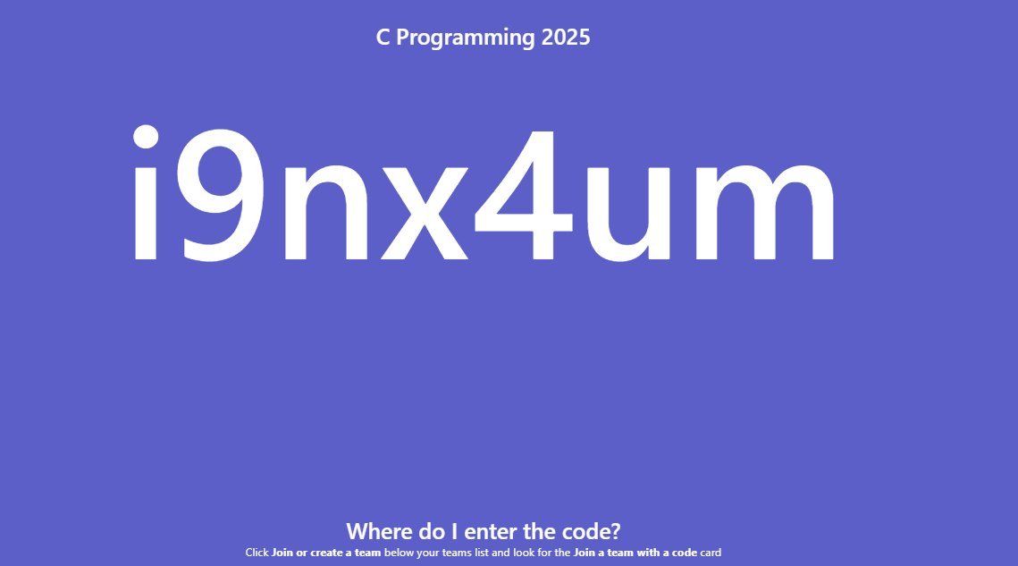
MS Team Code

Slide 18
Create your accounts…
Using your personal email account
On GITHUB
On LeetCode

Slide 19

Best Wishes!!!

